Slide 1
Making the link between ACT & Behaviour Analysis
Clinical Psychology
School of Health in Social Science
David Gillanders
Notes:
This template can be used as a starter file for presenting training materials in a group setting.
Sections
Sections can help to organize your slides or facilitate collaboration between multiple authors. On the Home tab under Slides, click Section, and then click Add Section.
Notes
Use the Notes pane for delivery notes or to provide additional details for the audience. You can see these notes in Presenter View during your presentation.
Keep in mind the font size (important for accessibility, visibility, videotaping, and online production)
Coordinated colors
Pay particular attention to the graphs, charts, and text boxes.
Consider that attendees will print in black and white or grayscale. Run a test print to make sure your colors work when printed in pure black and white and grayscale.
Graphics, tables, and graphs
Keep it simple: If possible, use consistent, non-distracting styles and colors.
Label all graphs and tables.

Slide 2
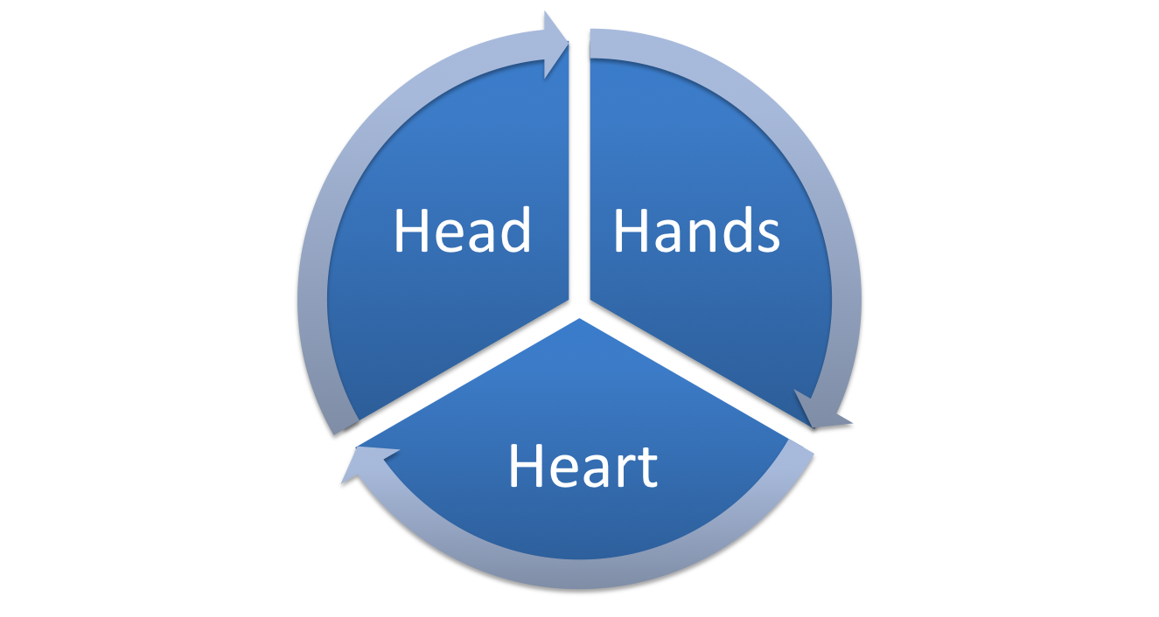
3 elements of ACT training
Knowledge & Concepts
Skills & Techniques
Personal Qualities

Slide 3
Clear Case Conceptualisation & Functional Analysis
Notes:
Use a section header for each of the topics, so there is a clear transition to the audience.

Slide 4
Behaviour Analysis
We all know the traditional ‘three term contingency’:
Antecedent
Behaviour
Consequence

Slide 5
Antecedents
Can be anything:
Events in the external world
Events in the internal world: thoughts
feelings
sensations
memories
urges

Slide 6
The Trap
If when A occurs, it reliably leads to B, and C is a less negative consequence, then that chain will be strengthened
Much of our client’s struggling is concerned with trying hard to control the occurrence of A.
The B’s that occur in response
to A often lead to a short term
reduction in intensity or presence
of A

Slide 7
Clinical Assessment as Functional analysis
So we go looking for problematic repertoires of this form:
Antecedent: unwanted emotions, memories, thoughts, sensations,
Behaviours: responses that are primarily focused on controlling Antecedents
Consequences: Short term reduction in what is struggled with, long term life constriction

Slide 8
Assessment
What is the client looking for help with?
Describing the struggle
Thoughts, beliefs, emotions, behaviours, social, historical
Emphasising the experience of what happens and of how they are responding

Slide 9
Functional analysis
What is the struggle?
What do they do in response?
What is the consequence of that?
How would they wish it to be different?

Slide 10
Case Conceptualisation
What are workable strategies?
What are unworkable ones?
Which of the 6 processes do we need to strengthen?
You can use the hexaflex model to map out what drives the current strategies

Slide 11
Case Example
John - early 30's, graphic designer
Chronic, severe irritable bowel syndrome, low mood, abdominal pain and discomfort
Low motivation, sense of defeat
Fears having a bowel accident in public, is very embarrassed and shamed
Feels disbelieved, has tried many things to control IBS
Has stopped socialising, changed his work to be more alone, stopped going out, stopped dating

Slide 12
Case Example - Functional analysis
Struggle: symptoms, beliefs / thoughts, feelings
Response: what he does in response to the struggle
Consequences?
How workable are these strategies?

Slide 13
The link between functional analysis and ACT
What combination of the 6 processes underpin or drive these unworkable strategies?
Strategy | Processes
Looking for a cure | Avoidance
 | Fusion with beliefs: 'there must be a cure'
Not socialising | avoiding judgements and shame, avoiding accidents
 | fusion with judgements about likelihood

Slide 14
The ACT Model of Inflexibility
Dominance of Past & Future
Lack of clarity or contact with Values
Experiential avoidance
Psychological inflexibility
Inaction, impulsivity or avoidant persistence
Cognitive Fusion
Attachment to the self ‘story’

Slide 15
Case Conceptualisation Exercise
In groups of three, one person choose to bring a case to work on
I have a few tips for you…

Slide 16
Getting out of the trap
Notes:
Use a section header for each of the topics, so there is a clear transition to the audience.

Slide 17
The 3 term contingency is only a tool…
Antecedent
Behaviour
Consequence

Slide 18
The continuous flow of behaviour…
Behaviour
Consequence
Antecedent

Slide 19
The continuous flow of behaviour…
not go to the party
Feel safer
“I’ll look stupid”

Slide 20
If you always do what you’ve always done…
In order to contact new contingencies, we need to establish new behaviours in response to the usual antecedents.
Then that consequence becomes part of a new antecedent and thereby: the stimulus function of A is altered

Slide 21
The continuous flow of behaviour…
I’m having the thought that…and stay at party
experience of responding differently to thinking
“I’ll look stupid”

Slide 22
The continuous flow of behaviour…
Greater choice over behaviour
self story less dominant
“I’ll look stupid”
different
responding

Slide 23
Other ways to alter the function of Antecedents
Modelling an alternative behaviour in response to A
instigating almost any other more flexible behaviour in the presence of A
What would you say to a friend that was thinking this thought…
Responding in an unconventional way to thinking

Slide 24
Language and Antecedents
Languageing around A can alter the stimulus functions of A by adding it into different relational framing:
Usually:
Difficult A framed in coordination with self
Difficult A framed as ‘bigger than’ self
Through exercises and talk:
‘Self’ framed in distinction and hierarchy with difficult A.
I love my husband but he makes me so angry…

Slide 25
What is the function?
What is occurring in functional terms
We will pause every few minutes to discuss
Use the tracking grid
Notes:
In this group exercise I’m going to suggest we explore the functions that may be occurring in ACT classic interventions

Slide 26
Summary
Behaviour analysis informing assessment
Problematic repertoires
Functions of the unworkable behaviours
What underpins these unworkable strategies?
Targeting treatment
Altering the stimulus functions by new behaviour
By additional framing
By altering context

Slide 27
Enquiry and Exploration
https://contextualscience.org/david_gillanders_training_page

